Slide 1

ShopSphere Software Architecture
Electronics E-Commerce Website
An overview of the architectural design, analysis, and implementation of an online retail platform for electronic products.
PHENIKAA SCHOOL OF COMPUTING

Slide 2
Electronics E-Commerce Website
ShopSphere Platform Architecture
A comprehensive exploration of software architecture patterns, from monolithic layered design to distributed microservices, demonstrating the evolution of a modern e-commerce system for electronic products.
Group 16
Semester
Class N01
Spring 2025
PHENIKAA SCHOOL OF COMPUTING

Slide 3

Project Introduction
Course Information
Team Members
Course: Software Architecture-1-2-25 (N01)
Nguyễn Tuấn Thiền – Student ID: 23010571
Đặng Việt Anh – Student ID: 23010689
Instructor: M.Sc. Vũ Quang Dũng
Academic Term: Spring 2025
This presentation documents our comprehensive journey through the Software Development Life Cycle (SDLC), exploring architectural patterns and design decisions that shaped the ShopSphere e-commerce platform.

Slide 4
Program Overview: Five Labs Covering Full SDLC Architecture
Our architecture course spans five comprehensive laboratory assignments, each building upon the previous to create a complete understanding of software system design. From initial requirements gathering to deployment analysis, we demonstrate the evolution of architectural thinking and implementation strategies.
01
02
03
Requirements Elicitation & Modeling
Layered Architecture Design
Microservices Decomposition & C4 Model
Identifying functional requirements, architecturally significant requirements, and creating use case diagrams to establish system scope and stakeholder needs.
Designing a traditional four-layer monolithic architecture with clear separation of concerns: presentation, business logic, persistence, and data layers.
Transitioning from monolith to microservices using business capability decomposition and documenting the system using the C4 modeling approach.
04
05
API Gateway Pattern
Deployment View & ATAM Analysis
Implementing a centralized gateway for routing, authentication, and authorization to manage distributed service communication securely.
Creating deployment diagrams showing physical infrastructure and conducting Architecture Tradeoff Analysis Method (ATAM) evaluation for quality attributes.

Slide 5

LAB 01
Requirements Elicitation & Modeling
Establishing the foundation of our system through comprehensive requirements analysis and use case modeling to capture stakeholder needs and system boundaries.

Slide 6



Lab 01: Functional Requirements
Our functional requirements analysis identified three primary actors and their interactions with the ShopSphere system. Each functional requirement was prioritized based on its criticality to system operation and business value delivery.
System Actors
Core Functional Requirements
ID
Description
Priority
Web Customer
FR-01
Browse & search products by keywords/categories
High
Browse, search, and purchase products
FR-02
Register account & securely log in
High
FR-03
Add products to cart & manage quantities
High
FR-04
Checkout with shipping info & payment processing
Critical
Administrator
FR-05
Submit product reviews and ratings
Medium
Manage products, categories, and orders
FR-06–10
Admin CRUD: categories, products, orders, articles
High
Payment Gateway
Process secure transactions

Slide 7




Lab 01: Architecturally Significant Requirements
Architecturally Significant Requirements (ASRs) are quality attributes that fundamentally shape our system design decisions. These non-functional requirements directly influence our choice of architectural patterns, technology stack, and implementation strategies.
ASR-1: Scalability
ASR-2: Security
ASR-3: Modifiability
Requirement: Support 500–5,000 concurrent users during peak sales events
Requirement: Admin access via secure token authentication; encrypted payment data transmission
Requirement: Add new payment gateways without affecting other system modules
Architectural Impact: Necessitates horizontal scaling capabilities, load balancing infrastructure, distributed caching strategies, and stateless service design
Architectural Impact: Requires Layered Architecture with clear separation of concerns, interface-based design, and dependency injection patterns
Architectural Impact: Drives adoption of API Gateway Pattern, token-based authentication middleware, and secure communication protocols (HTTPS/TLS)

Slide 8
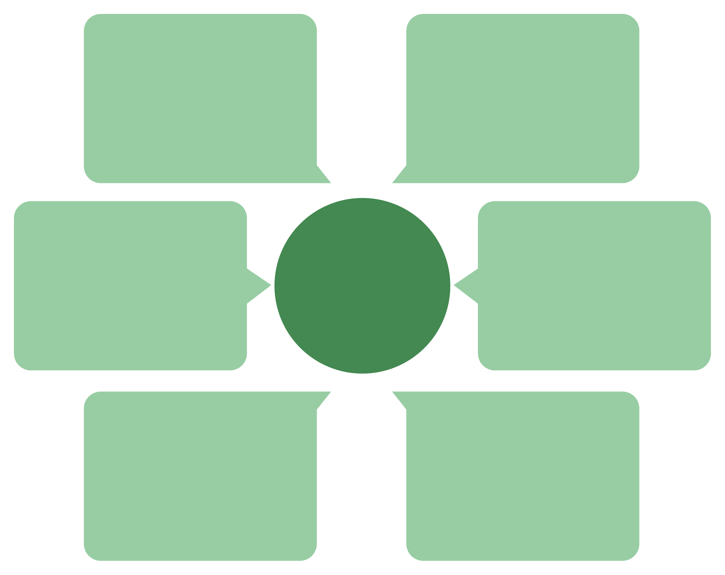
Lab 01: Use Case Diagram
System Functional Scope and Actor Interactions
The use case diagram provides a high-level view of system functionality organized by actor roles. It demonstrates the boundaries of our e-commerce system and the primary interactions between users, administrators, and external payment services.
Manage Cart
Web Customer
Add, update, remove items
Browse, register, cart, purchase, review
Register/Login
E-Commerce System
Admin
Create or access account
Manage products and process orders
Browse Products
Payment Gateway
View product catalog
Handles payment for purchases
This functional model establishes clear boundaries between customer-facing features, administrative operations, and third-party integrations. It serves as the foundation for our subsequent architectural design decisions and component decomposition.

Slide 9

LAB 02
Layered Architecture Design
Implementing a traditional four-tier monolithic architecture to establish clear separation of concerns and facilitate initial development velocity.

Slide 10
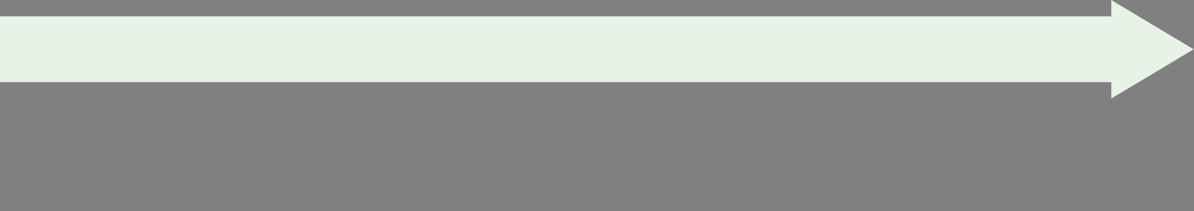
Lab 02: Defining the Four Standard Layers
The layered architecture pattern organizes our system into horizontal layers, each with distinct responsibilities. This separation enables independent development and testing of each layer while maintaining clear interfaces between components.
Business Logic Layer
Presentation Layer
Responsibilities: Implement core business rules, perform data validation, orchestrate workflows, and manage transaction boundaries
Responsibilities: Handle HTTP requests, manage authentication/authorization, maintain session state, and render user interfaces
Components: Service classes, business rule validators, domain models
Components: Controllers, middleware, view templates, routing logic
Data Layer
Persistence Layer
Responsibilities: Provide physical data storage, ensure data integrity, and optimize query performance
Responsibilities: Map domain objects to database entities, execute CRUD operations, and manage data access patterns
Components: MySQL database schema, tables, indexes, constraints
Components: Repository interfaces and implementations, data mappers, query builders

Slide 11
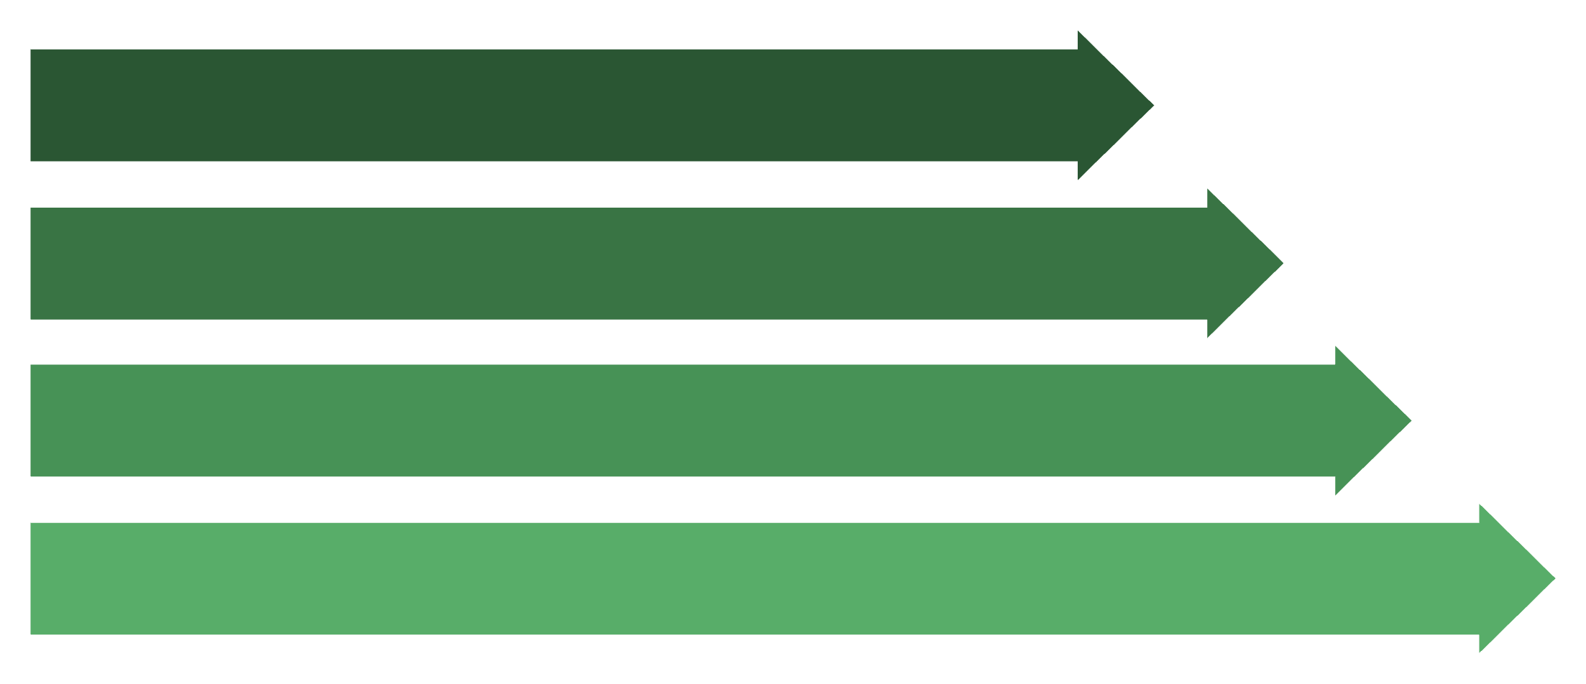
Lab 02: Request Flow Through Layers
View Product Details – End-to-End Data Flow
This sequence demonstrates how a simple product detail request traverses through all architectural layers, illustrating the data transformation and responsibility delegation at each tier. Understanding this flow is crucial for debugging, performance optimization, and identifying potential bottlenecks.
Client GET
Product Controller
Product Service
Product Repository
01
02
03
Client Request Initiation
Controller Reception
Business Logic Processing
Browser sends HTTP GET /products/{id} to the web server
ProductController receives request, validates parameters, calls productService.getProductDetails(id)
ProductService applies business rules (pricing, availability checks), delegates data retrieval to repository
04
05
Data Persistence Query
Response Assembly & Return
ProductRepository constructs and executes SQL query against MySQL database
Data flows back through layers: DB → Repository → Service → Controller → Client, with appropriate transformations (DTO mapping, JSON serialization)

Slide 12
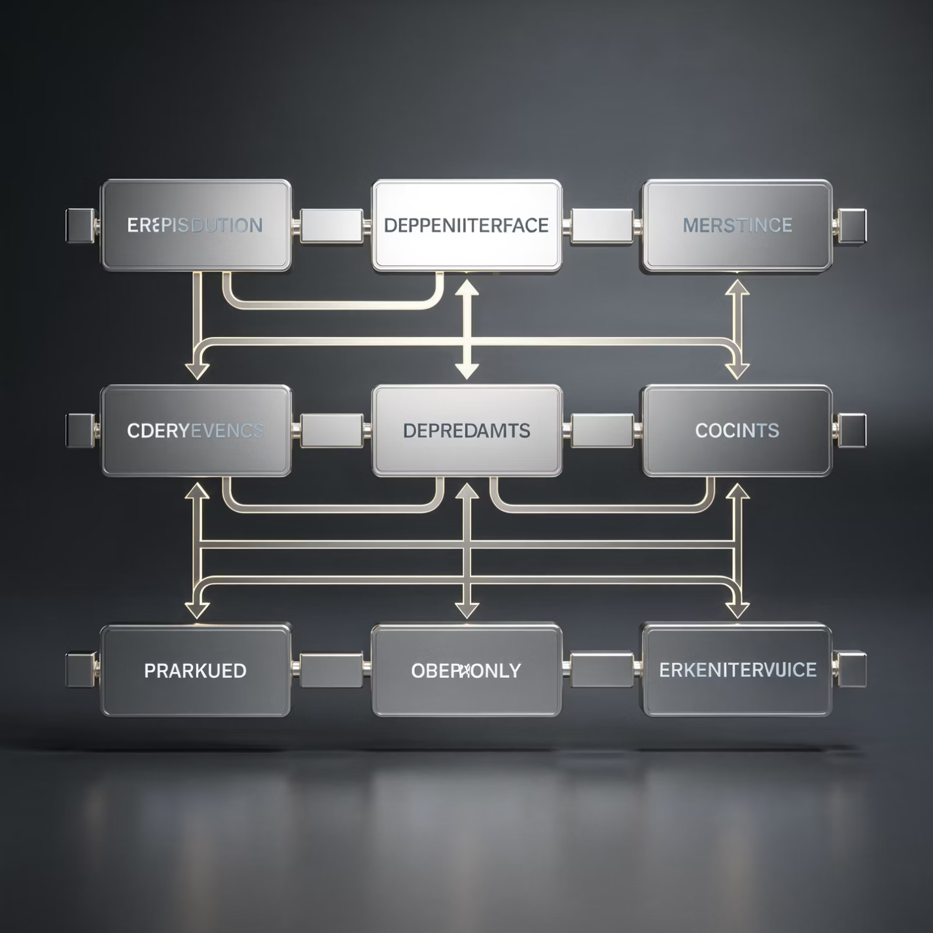
Lab 02: Component Diagram
UML Component View – Product Catalog Feature
The component diagram illustrates the static structure of our layered architecture, focusing on the Product Catalog feature. It shows the dependencies between components across different layers and the interfaces they expose.
Component Relationships
Presentation Layer
ProductController handles HTTP requests and delegates to business layer
Business Logic Layer
ProductService implements IProductService interface, encapsulates business rules
Persistence Layer
ProductRepository implements IProductRepository interface, handles data access
The use of interfaces (IProductService, IProductRepository) enables dependency inversion, facilitating unit testing through mock implementations and supporting future architectural evolution.

Slide 13

Lab 02: Layered Architecture Trade-offs Analysis
Every architectural pattern involves trade-offs between competing quality attributes. Our analysis reveals that while layered monolithic architecture provides simplicity and rapid development, it fundamentally struggles with scalability demands—a critical ASR for e-commerce systems.
Aspect
Advantages
Disadvantages
Simplicity
Easy to understand and implement; enables rapid development for small teams
—
Scalability
—
Must scale entire monolith even if only one module experiences high load
Testability
Each layer can be tested in isolation by mocking the layer below
—
Deployment
—
Any change requires redeploying the entire application, increasing risk
Maintainability
Changes in one layer don't affect others if interfaces are preserved
Performance overhead from data transformation between layers
Conclusion
The layered monolithic architecture serves as an excellent starting point for understanding architectural patterns and rapid prototyping. However, it fundamentally fails to meet our Scalability ASR (supporting 500–5,000 concurrent users). This limitation motivates our evolution toward microservices architecture in subsequent labs.

Slide 14

LAB 04
Microservices Decomposition & C4 Model
Transitioning from monolithic to distributed architecture using business capability decomposition and comprehensive system modeling.

Slide 15
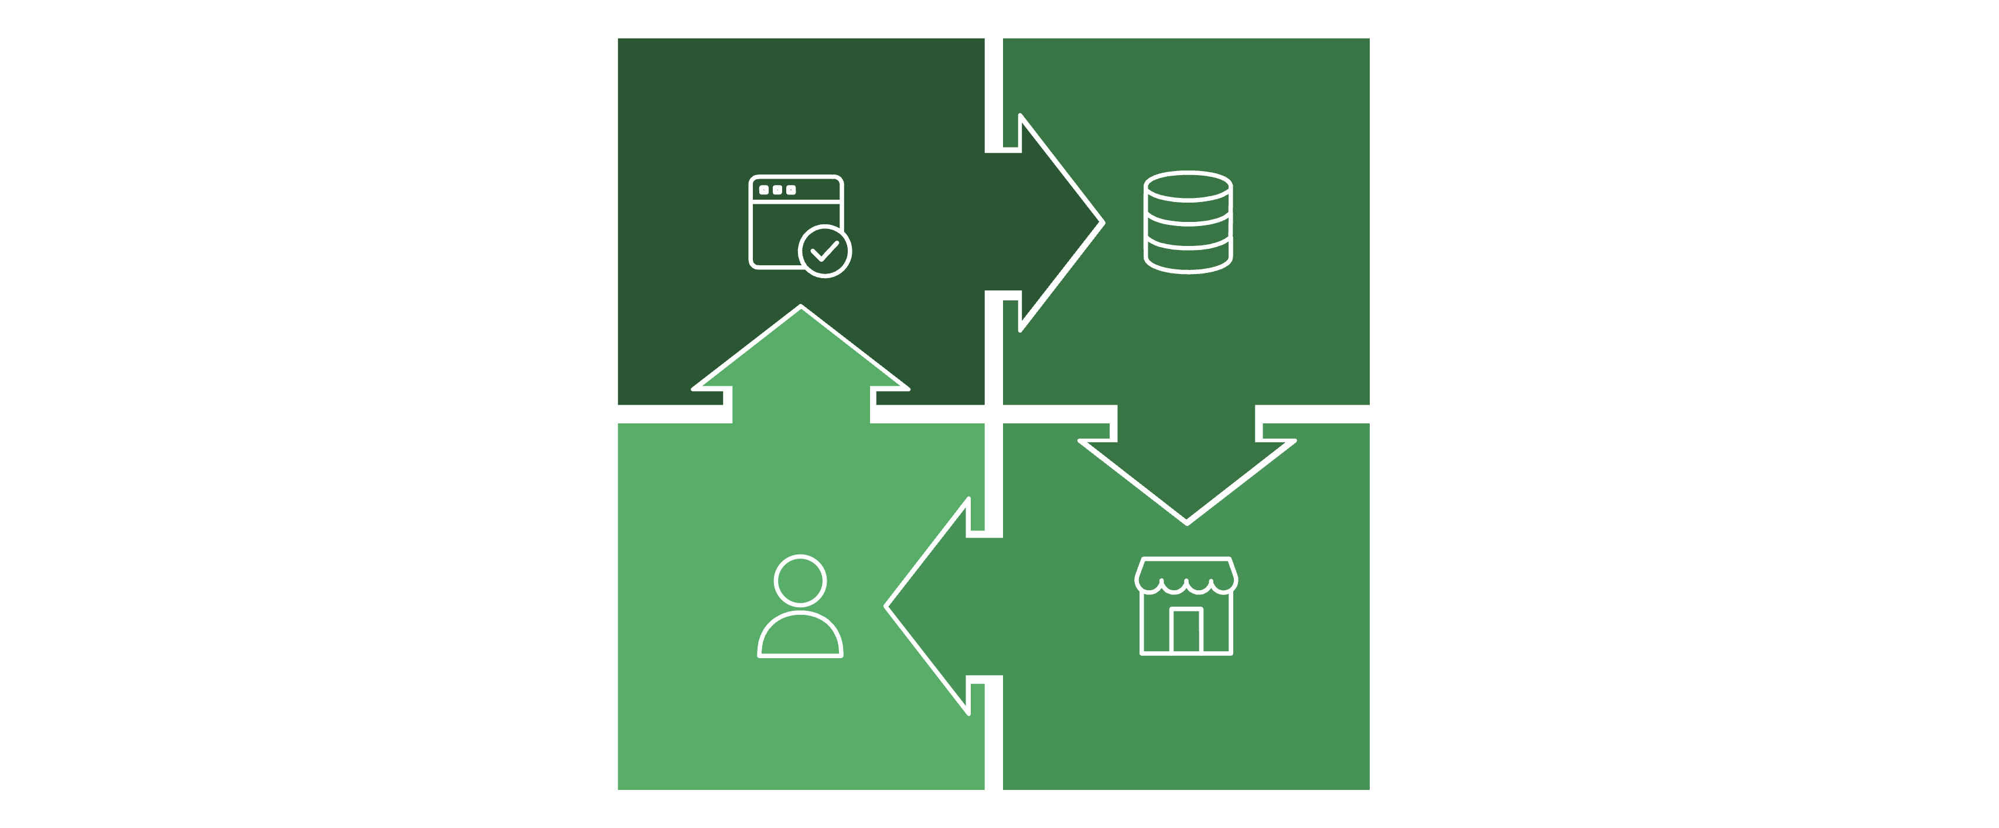










Lab 04: Business Capability Decomposition
From Monolith to Microservices
We decomposed the monolithic system by identifying distinct business capabilities, each representing a cohesive domain with clear boundaries. This approach ensures each microservice owns its data and can be developed, deployed, and scaled independently.
Monolith
Catalog
Users & Payments
Cart & Order
Catalog Service
Cart Service
Order Service
User Service
Manages product information, categories, search, and reviews
Handles shopping cart operations and temporary item storage
Processes orders, manages order lifecycle and shipping
User authentication, authorization, and profile management
Payment Service
Notification Service
Integrates with payment gateways (MoMo, VNPay)
Sends order confirmations and alerts via email/SMS

Slide 16
Lab 04: Communication Strategy
Synchronous vs Asynchronous Patterns
Choosing the right communication pattern is critical for microservices architecture. We employ both synchronous and asynchronous approaches based on specific use case requirements, balancing response time needs with system resilience and fault isolation.
⚡ Synchronous Communication (REST/HTTP)
📨 Asynchronous Communication (Events/Message Queue)
When to use: User needs immediate response and data consistency is critical
When to use: Non-blocking operations where fault isolation and eventual consistency are acceptable
Use cases:
Product browsing and search (Catalog Service)
Cart price lookup (Cart → Catalog API)
Checkout process validation (Order Service)
Use cases:
Order confirmation emails (non-critical)
Inventory updates after purchase
Analytics and reporting events
Key principle: No shared databases—Cart Service calls Catalog API to get product information rather than directly accessing Catalog's database
Implementation: Outbox Pattern with Redis Queue ensures reliable event delivery. Notification Service consumes OrderPlaced events and processes them asynchronously, preventing email delivery failures from blocking order completion.

Slide 17
Lab 04: C4 Model – System Context (Level 1)
High-Level System View and External Dependencies
The C4 model provides a hierarchical approach to documenting software architecture. Level 1 (System Context) shows the ShopSphere system as a black box, illustrating its relationships with users and external systems. This bird's-eye view helps stakeholders understand the system's boundaries and key interactions.
C4 Level 1: System Context
C4 Level 2: Container
C4 Level 3: Component
C4 Level 4: Code
Reveals major application containers (API Gateway, services, databases)
Details internal components within each container
Shows implementation details (classes, interfaces)
Shows system boundary and external actors
Our architecture documentation spans all four C4 levels, providing different perspectives for different stakeholder groups: business users focus on L1, architects on L2-L3, and developers on L3-L4.

Slide 18
Lab 04: Service Contracts
API Endpoint Definitions and Interface Specifications
Well-defined service contracts are essential for microservices architecture. Each service exposes a clear RESTful API that other services consume. These contracts enable independent development and testing while ensuring consistent integration patterns across the system.
Service
Endpoint
Method
Description
Catalog
/api/products
GET
List and search products with filters (category, price range, keywords)
Catalog
/api/products/{id}
GET
Retrieve detailed product information including specs, reviews, and availability
Cart
/api/cart
POST
Add product to shopping cart with specified quantity
Cart
/api/cart/{id}
DELETE
Remove item from cart by cart item identifier
Order
/api/orders
POST
Create new order from cart contents with shipping details
Payment
/payment/{method}/{txn}/init
POST
Initiate payment transaction with selected gateway (MoMo/VNPay)
Database-per-Service Pattern
Critical rule: Services must NOT share databases. For example, Cart Service calls Catalog Service's REST API to retrieve product information rather than directly querying Catalog's database. This ensures loose coupling and independent scalability.

Slide 19

LAB 06
API Gateway Pattern
Implementing centralized routing, authentication, and authorization to secure and simplify microservices communication.

Slide 20
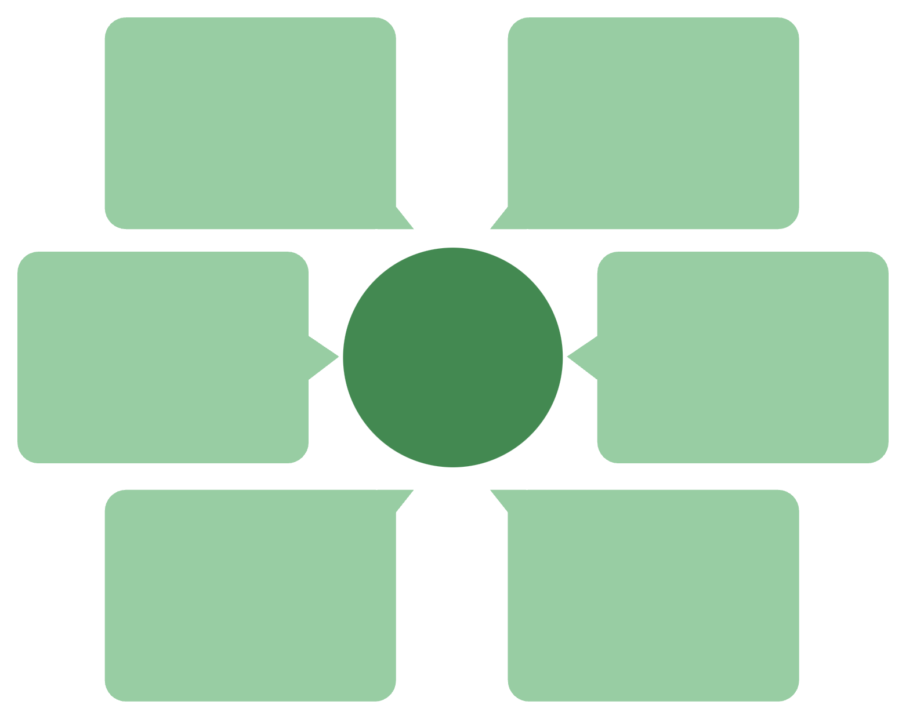
Lab 06: API Gateway Architecture
Reverse Proxy with Security Stub Implementation
The API Gateway serves as the single entry point for all client requests, providing cross-cutting concerns including authentication, authorization, rate limiting, and request routing. This pattern simplifies client interactions by presenting a unified API facade while routing requests to appropriate backend microservices.
MySQL Database
Client
Product data storage
Sends requests to Port 5000
API Gateway Request Flow
Product Service
API Gateway
Forwards on Port 5001
Receives on Port 5000
Admin Role Check
Token Validation
Authorize admin privileges
Authenticate request token
Gateway Responsibilities
Implementation Details
Authentication
Authorization
Technology Stack: Laravel framework with custom middleware
Port Configuration:
Validate Bearer tokens using GatewayTokenMiddleware before forwarding requests
Enforce role-based access control—POST/PUT/DELETE operations require admin token
API Gateway: Port 5000 (external-facing)
Product Service: Port 5001 (internal)
Security Model: JWT-based authentication with role attributes embedded in token payload. Gateway validates token signature and expiration before checking role claims.
Request Routing
Error Handling
Fault Tolerance: When backend service is unavailable, gateway returns HTTP 503 (Service Unavailable) rather than exposing internal connection errors.
Forward validated requests to appropriate backend services using Laravel HTTP client
Return consistent error responses (401, 403, 503) to clients

Slide 21





Lab 06: Gateway Testing Results
Response Scenarios and Security Validation
Comprehensive testing validates that our API Gateway correctly enforces security policies while maintaining system usability. Each test case demonstrates a specific aspect of gateway behavior, from authentication to authorization to fault handling.
Test
Condition
Status
Response
A
No Authorization header present in request
401
{"error": "Missing or invalid token"}
B
Valid user token with GET request
200
JSON product list successfully returned from backend
C
User token attempting POST/PUT/DELETE
403
{"error": "Admin token required for this operation"}
D
Product Service is down or unreachable
503
{"error": "Product service currently unavailable"}
Request Received
Gateway receives incoming HTTP request
Token Validation
Verify token signature, expiration, and format
Role Authorization
Check if token role matches required permission
Forward Request
Route to appropriate backend service
Return Response
Send service response or error to client

Slide 22

LAB 08
Deployment View & ATAM Analysis
Documenting physical infrastructure and conducting Architecture Tradeoff Analysis Method evaluation for quality attribute satisfaction.

Slide 23






Lab 08: UML Deployment Diagram
Physical Architecture and Infrastructure Components
The deployment diagram illustrates how our logical architecture maps to physical infrastructure, showing the distribution of services across servers, network topology, and data storage patterns. This view is essential for understanding operational requirements, scalability planning, and deployment strategies.
Load Balancer
API Gateway
Service Layer
Data Layer
Nginx distributes HTTPS traffic across multiple gateway instances for high availability
Kong gateway provides authentication, rate limiting, and service routing
Catalog, Order, User, and Notification services deployed as independent containers
Database-per-service pattern ensures data isolation and independent scaling
Redis Cache
RabbitMQ
Distributed caching reduces database load and improves response times
Message broker enables asynchronous event-driven communication between services

Slide 24
Lab 08: ATAM Quality Analysis
Scalability & Availability Scenario Evaluation
The Architecture Tradeoff Analysis Method (ATAM) evaluates how well our architecture satisfies quality attribute requirements. We analyze specific scenarios that stress critical quality attributes, comparing monolithic vs. microservices responses.
Scenario SS1: Scalability During Flash Sale
Scenario AS1: Availability During Service Failure
Stimulus: Traffic spike of 10× normal load during flash sale event (5,000 concurrent users)
Stimulus: Notification Service experiences 1-hour downtime due to SMTP provider outage
❌ Monolith Response
✅ Microservices Response
❌ Monolith Response
✅ Microservices Response
Must scale entire application as single unit. Even if only Catalog module is stressed, all components (Admin, Payment, Notification) scale unnecessarily, wasting resources. Single bottleneck affects all functionality.
Tight coupling creates risk of cascading failure. If email module blocks or throws exceptions, it may prevent order completion. All confirmation emails lost permanently.
Scale only Catalog and Order services horizontally by spinning up additional container instances. Cart, User, Payment, and Notification services remain at normal capacity. Independent scaling optimizes resource utilization and cost.
Orders continue processing normally. OrderPlaced events queue in RabbitMQ. After Notification Service recovers, it processes queued messages and sends delayed confirmations. Partial failure doesn't impact core business flow.

Slide 25

Lab 08: Architecture Trade-offs Summary
Monolith vs Microservices Comprehensive Comparison
No architecture is universally superior—each pattern involves trade-offs between competing quality attributes. Our analysis demonstrates that microservices better satisfy our critical ASRs (scalability, availability) but introduce operational complexity that must be carefully managed.
Criteria
Monolith (Layered)
Microservices
Scalability
Scale entire application as single unit; inefficient resource utilization
Scale individual services independently based on specific load patterns
Availability
Single point of failure; one module crash affects entire system
Partial failure isolation; critical services remain available during outages
Complexity
Low operational complexity; single deployment artifact and codebase
High complexity: API gateway, message queues, distributed tracing, multiple databases
Dev Speed
Fast initial development for small teams with shared codebase
Slower initial setup; faster long-term evolution with independent team ownership
Data Mgmt
Shared database simplifies transactions and queries
Database-per-service complicates cross-service queries and distributed transactions
Testing
Simpler integration testing in single environment
Requires contract testing, service virtualization, and sophisticated test environments
Architectural Decision Rationale
Microservices architecture improves scalability and availability at the cost of significantly higher operational complexity. For ShopSphere, a growing e-commerce platform with flash sale requirements and high availability needs, this trade-off is justified. The benefits of independent scaling and fault isolation outweigh the complexity burden.

Slide 26
SUMMARY
Conclusion & Reflection
Synthesizing architectural insights and future directions for the ShopSphere e-commerce platform.

Slide 27





Conclusion & Key Takeaways
Our journey through five laboratory assignments demonstrates the evolution of architectural thinking—from requirements-driven design to quality attribute analysis. Each lab built upon previous work, illustrating how architectural decisions cascade through the development lifecycle.
Lab 01: Requirements Foundation
Lab 02: Layered Simplicity
Lab 04: Microservices Decomposition
Architecture is fundamentally driven by non-functional requirements. Architecturally Significant Requirements (ASRs) like scalability, security, and modifiability dictate pattern choices and technology decisions.
Layered monolithic architecture provides simplicity and rapid development velocity but fundamentally sacrifices independent scalability—a critical requirement for e-commerce systems.
Business capability decomposition enables independent service scaling, deployment, and team ownership. Database-per-service pattern ensures loose coupling at the cost of distributed data management complexity.
Lab 06: Gateway Pattern
Lab 08: Quality Validation
API Gateway enforces security policies centrally, provides a unified API facade, and simplifies client integration while introducing a potential single point of failure that requires careful operational planning.
ATAM analysis objectively validates that microservices architecture better satisfies scalability and availability quality attributes, justifying the operational complexity trade-off for our use case.
Future Directions
Cloud-Native Deployment: Migrate to Kubernetes for container orchestration, auto-scaling, and self-healing capabilities
Observability: Implement distributed tracing (Jaeger), centralized logging (ELK stack), and metrics dashboards (Grafana)
Advanced Features: Machine learning recommendation engine, real-time inventory synchronization, progressive web app capabilities
Media Handling: Content delivery network (CDN) integration for product images and video demonstrations

Slide 28
References
Course Materials & Lab Documentation
Implementation Repository
Lab 1: Requirements Elicitation & Modeling – Course Materials, Software Architecture N01, Spring 2025
Lab 2: Layered Architecture Design (Logical View) – Course Materials, Software Architecture N01
Lab 4: Microservices Decomposition & Communication Patterns – Lab Handout, Phenikaa University
Lab 6: API Gateway Pattern Implementation – Lab Handout, Software Architecture Course
Lab 8: Deployment View & ATAM Analysis – Lab Handout and Assessment Rubric
GitHub Repository:
https://github.com/ntt2308/webbanhang.git
The repository contains complete source code for both monolithic (Laravel layered architecture) and microservices implementations, including:
Database schema and migrations
Service implementations with RESTful APIs
API Gateway middleware and routing configuration
Docker Compose deployment scripts
Integration test suites
Architecture documentation and diagrams
Academic & Professional Resources
Kruchten, Philippe. "The 4+1 View Model of Architecture." IEEE Software, Vol. 12, No. 6, November 1995, pp. 42-50
Sommerville, Ian. Software Engineering, 9th Edition. Addison-Wesley, 2011. Chapters on Architectural Design and Distributed Systems
Additional Standards & Frameworks
C4 Model for Software Architecture Visualization
ATAM (Architecture Tradeoff Analysis Method) – SEI Carnegie Mellon
RESTful API Design Best Practices
Microservices Patterns by Chris Richardson
PHENIKAA SCHOOL OF COMPUTING
PAGE 27

Slide 29
Thank You
Group 16 – Electronics E-Commerce Website
Software Architecture – Class N01
We appreciate your attention and welcome any questions about our architectural design decisions, implementation strategies, or future evolution plans for the ShopSphere platform.
5
6
2
Labs Completed
Microservices
Team Members
Full SDLC architecture coverage
Independent scalable components
Collaborative architecture design
PHENIKAA SCHOOL OF COMPUTING

